Slide 1
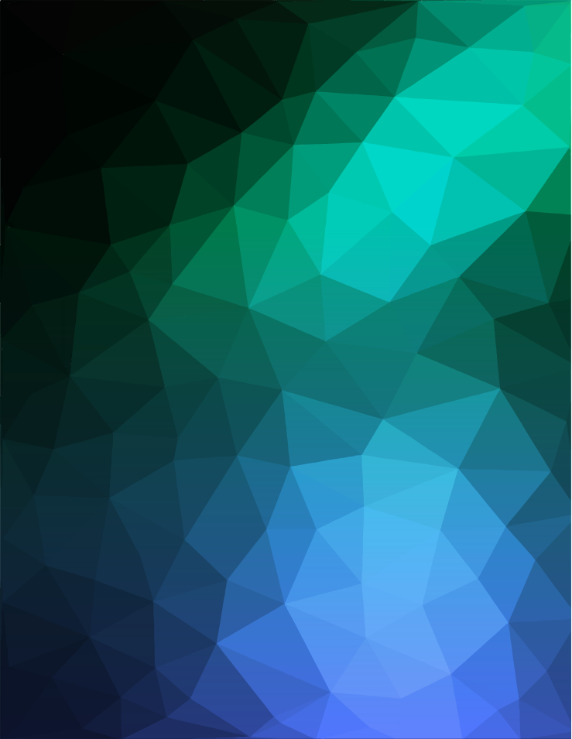

GOOD GAME DATABASE
Name: Reeve Jarvis
Project #: 8
Project title: App Development
Benchmark: 3 (Complete Product)

Slide 2
About GGDB…
What is GGDB?
GGDB is a gamer-focussed web-application created to assist today’s gamer. It is a tool to help indecisive gamers get the information they need, and find their new favorite game in the process.
Keep track of top games based on categories: popular, new releases, and most anticipated
Find specific details for any game (platforms, number of players, genre, gallery etc.)
Find quality game reviews linked to source material

Slide 3
About GGDB…
Who is GGDB for?
Gaming is currently the fastest growing, and largest entertainment industry in the world.
Large audience of all ages
Market share bigger than film and music combined
Expected Users:
Casual gamers looking for a new game to play
Die-hard gamers looking to check reviews on an anticipated releases
Video Game Journalists who want to stay up to date, track trends

Slide 4
About GGDB…
How did I make this app?
Html - Structural markup
CSS/SASS - Styling and layout
JavaScript - Programming
ES6 Modules
Express/Node.js
API Data integration

Slide 5
About GGDB…
API Usage
To build my application, I leveraged the following API’s for game and review data:
RAWG Video Games Database API (v1.0)
Game Lists Endpoint: https://api.rawg.io/api/games
Game Details Endpoint: https://api.rawg.io/api/games/{id}
Game Screenshots Endpoint: https://api.rawg.io/api/games/{game_pk}/screenshots
Gamespot API
Game Identifier Endpoint: http://www.gamespot.com/api/games/
Game Review Endpoint: http://www.gamespot.com/api/reviews/

Slide 6
Context…
Why did I choose this project?
Gaming is my biggest passion
Wanted to meet a user-need
Showcase my talents in web development
JavaScript
HTML
CSS/SASS
What's with the name?
Short for good game, the acronym GG is commonly used in online gaming at the end of matches as a gesture of good sportsmanship.

Slide 7
Prior Work Completed
Benchmark 1
Benchmark 1 involved the planning and design portions of my project. This stage involved producing the following resources to guide my development:
Moodboard - Moodboard
Wireframes - Wireframes
1 Page Style-guide - Style Guide
XD-Prototype - XD Prototype
Testing plan - Testing Plan

Slide 8
Prior Work Completed
Benchmark 2
Benchmark 2 involved the initial development of my application, with the aim of producing a minimum viable product. For this stage I completed:
Study and Research - Study and Research Plans/Links
GitHub Repository Setup - https://github.com/ItsJustJarvis/CapstoneProject-GGDB
MVP - Minimum Viable Product Implementation

Slide 9
Progress - Benchmark 3
Deliverables
Benchmark 3 involved the final development work of my application, with the aim of producing a complete product based off my MVP. For this stage I completed:
Complete Functional Product - https://ggdb-goodgamedatabase.herokuapp.com
Accessibility Plan (carried over from previous benchmark) - Accessibility Plan
Testing Report - Testing Report

Slide 10
Progress - Benchmark 3
Complete Product -
In order to further improve my minimum viable product I focussed on the following elements:
Visual Improvements
Standardized presentation of game cards
Add visual separation
Improve overlays and effects
Add loading animation
Code Refactoring/Reduction
Responsive Presentation
https://ggdb-goodgamedatabase.herokuapp.com/index.html

Slide 11
Progress - Benchmark 3
Planned Feature Updates
Due to time constraints I was unable to implement some more advanced features I had planned. I will be working to address these in the future, as this will be an ongoing passion project for me. Features include:
User Profile Management
Game List Creation (Library, Wish Lists etc.)
Game suggestions based on interest
In-depth search filtering
Search result view changes
Carousel Scrolling for curated game lists on home screen

Slide 12
Progress - Benchmark 3
Accessibility Plan -
To address accessibility concerns, and create a product that is usable from a wide audience I focussed on the following elements in my design:
Semantic markup usage and proper page hierarchy
Correct labelling and alt text for form fields, buttons, and images
Appropriate color contrast between elements
Font-selection with a focus on readability
Clear and operable interface
Accessibility Plan

Slide 13
Progress - Benchmark 3
Testing Report -
After finalizing my code and deploying my application, I conducted a series of tests to ensure I met the following criteria:
Pass standard code validation tests - W3C Validators
Be responsive to various devices - Browser DevTools, User Testing
Maintain accessibility for a wide audience - WAVE Accessibility Tool, Lighthouse Tests
Meet efficiency/speed test expectations - Lighthouse Tests
Pass a Quality Assurance review - User Testing
Testing Report

Slide 14
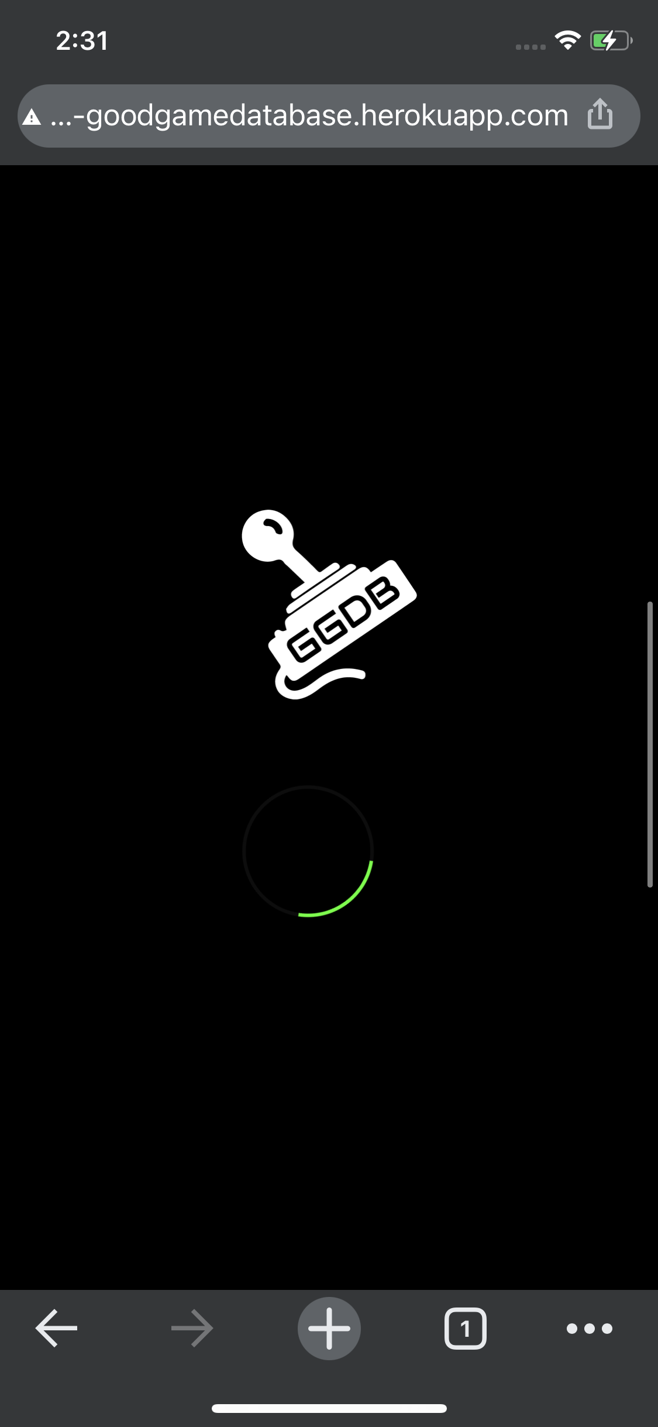
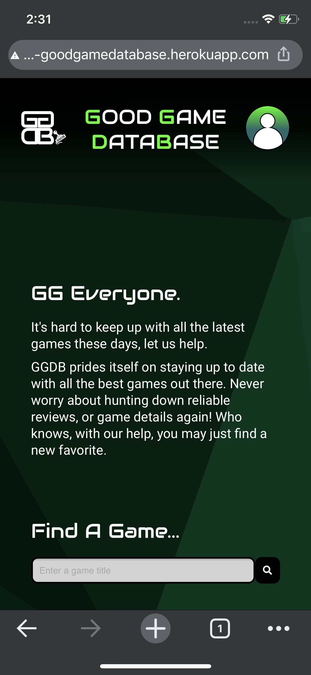
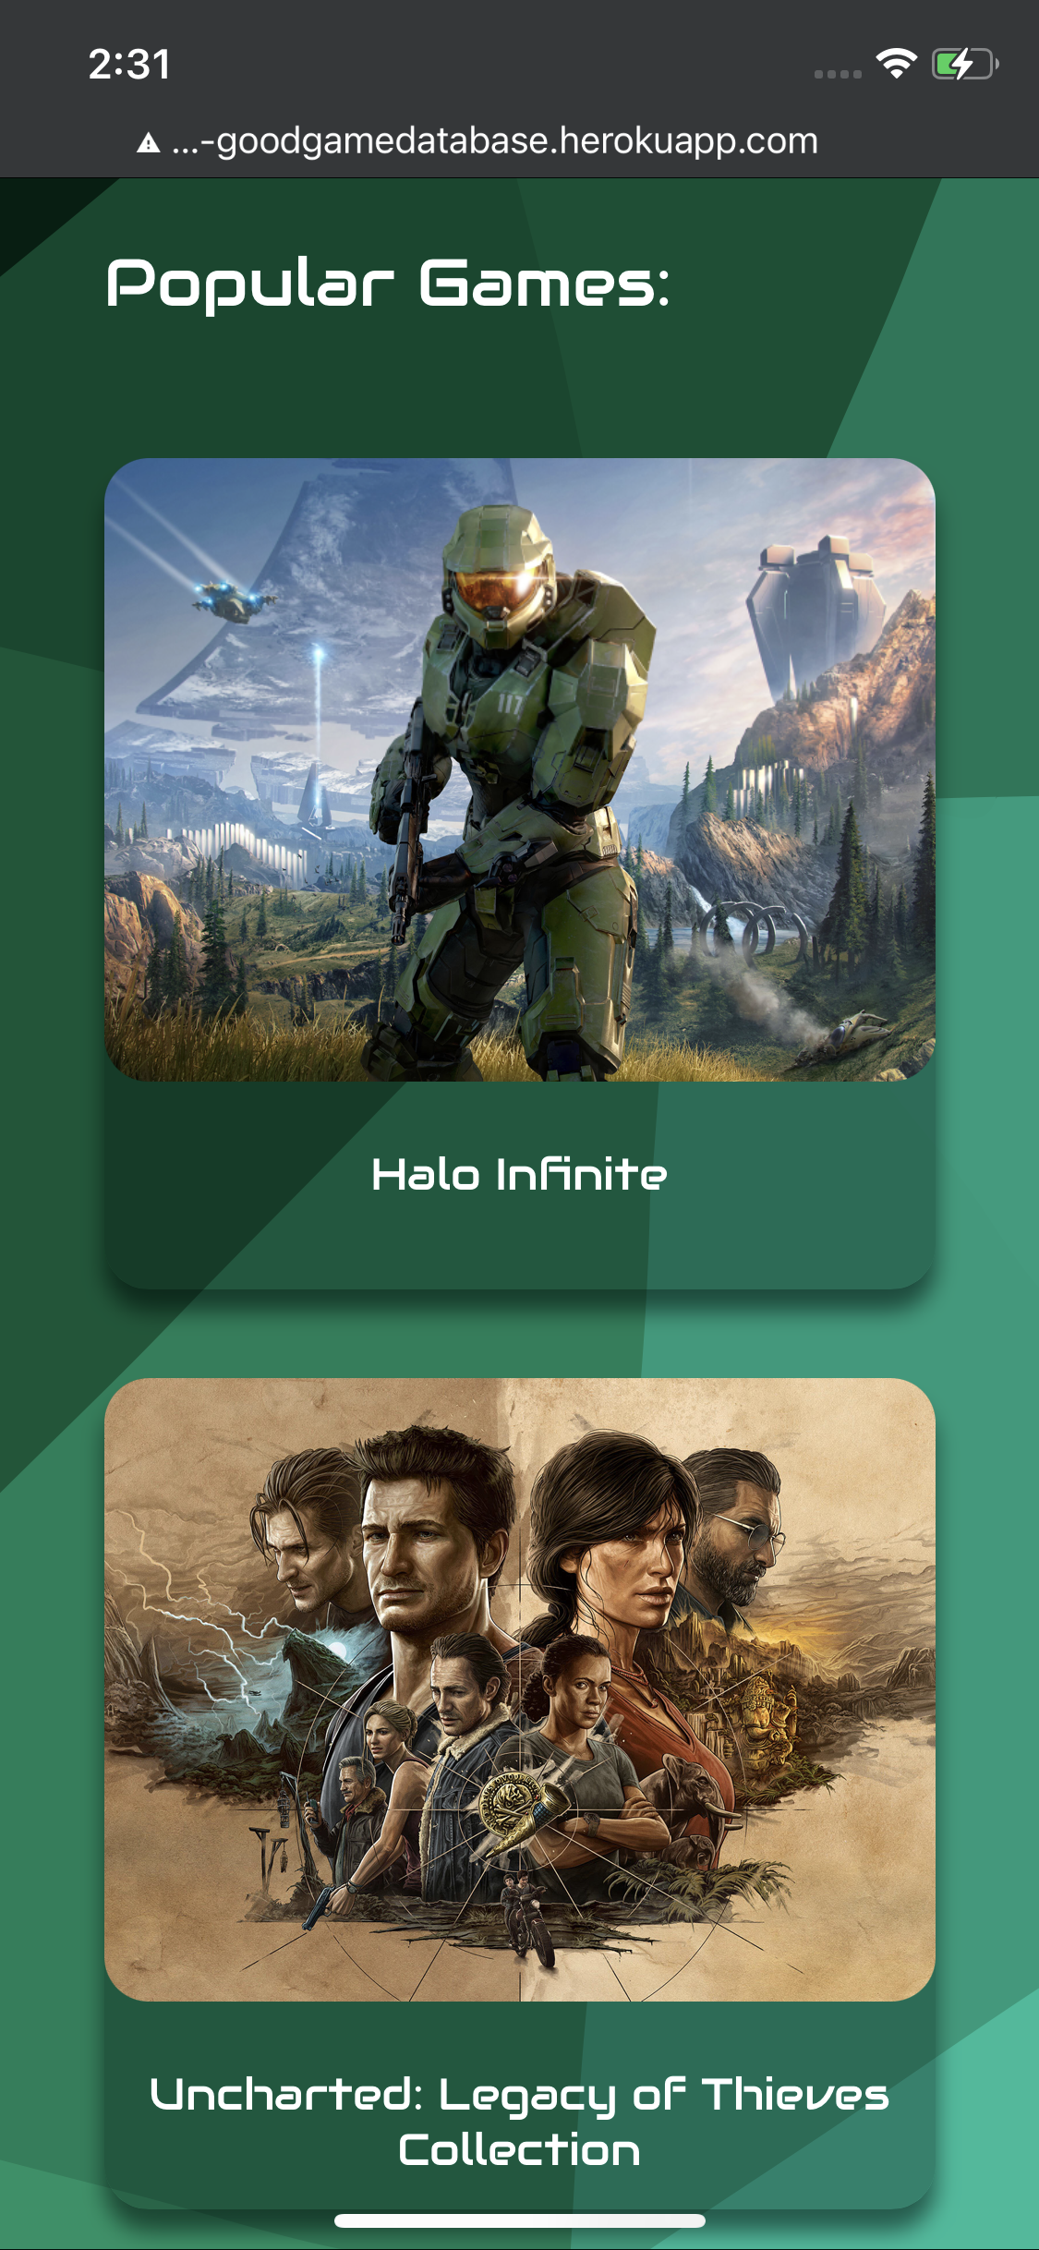
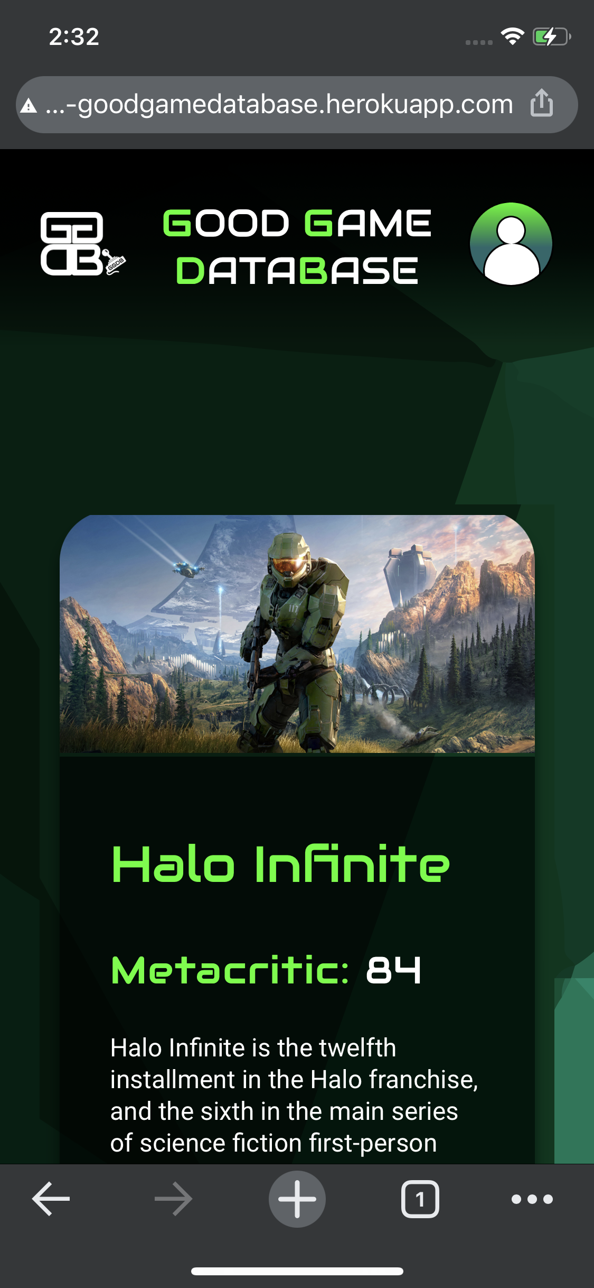
Progress - Benchmark 3
iPhone Screenshots - Part 1

Slide 15
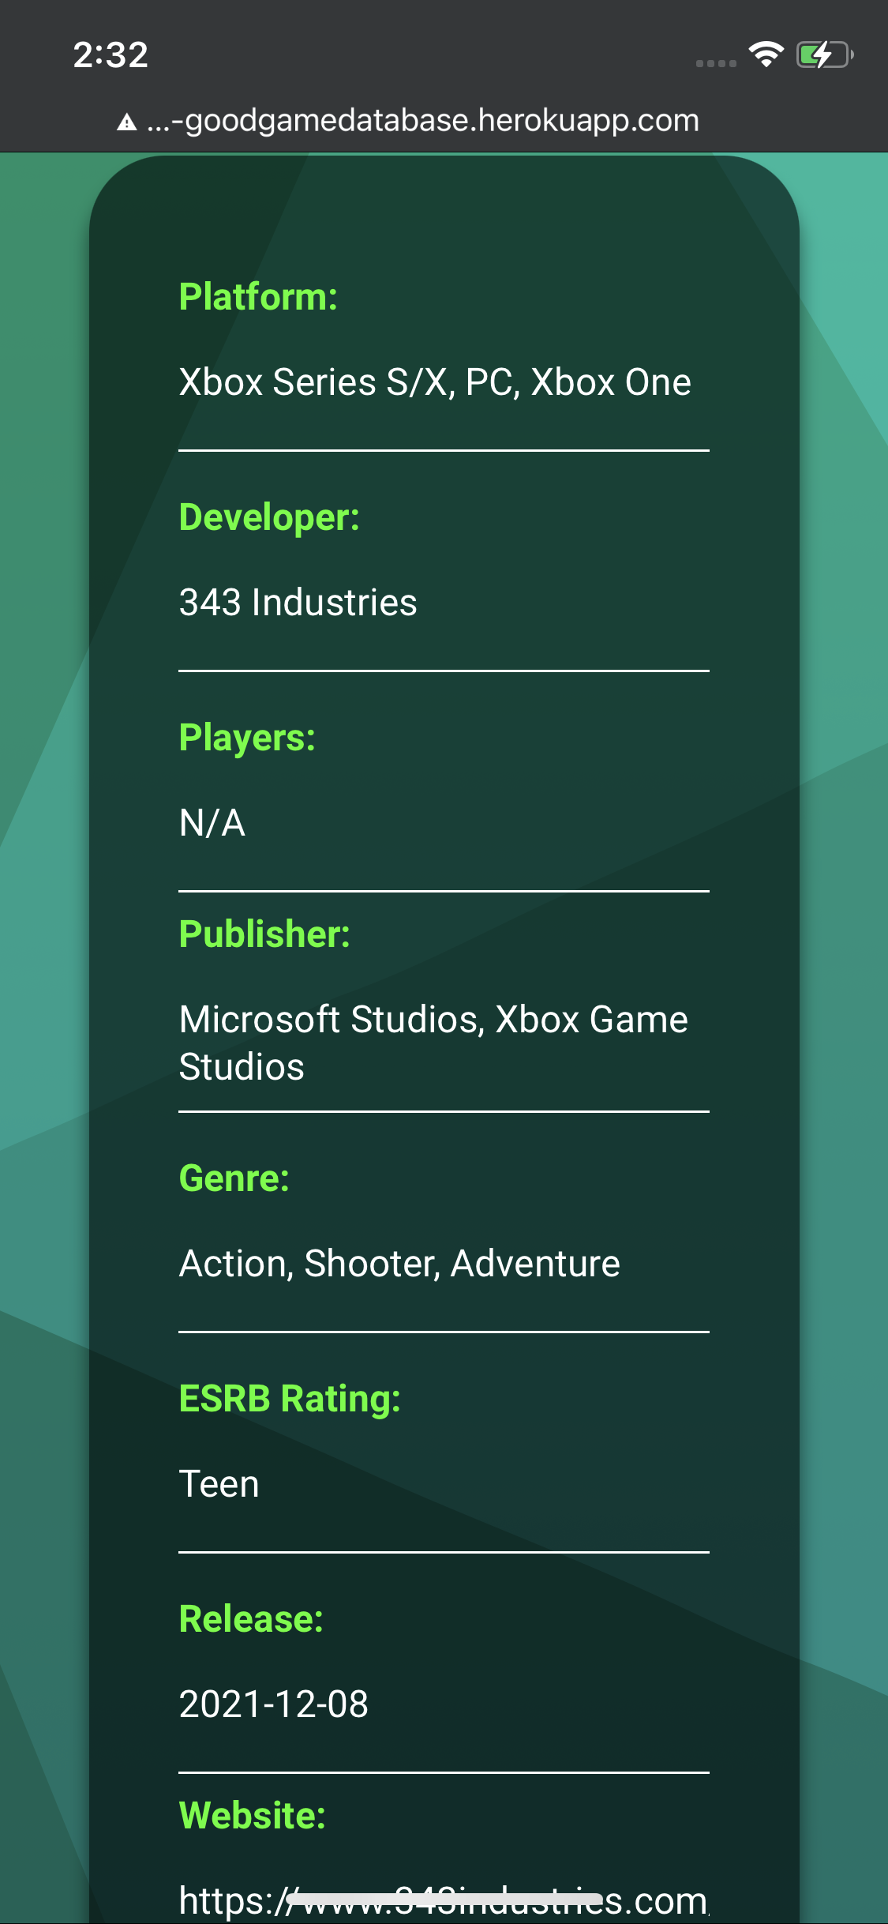
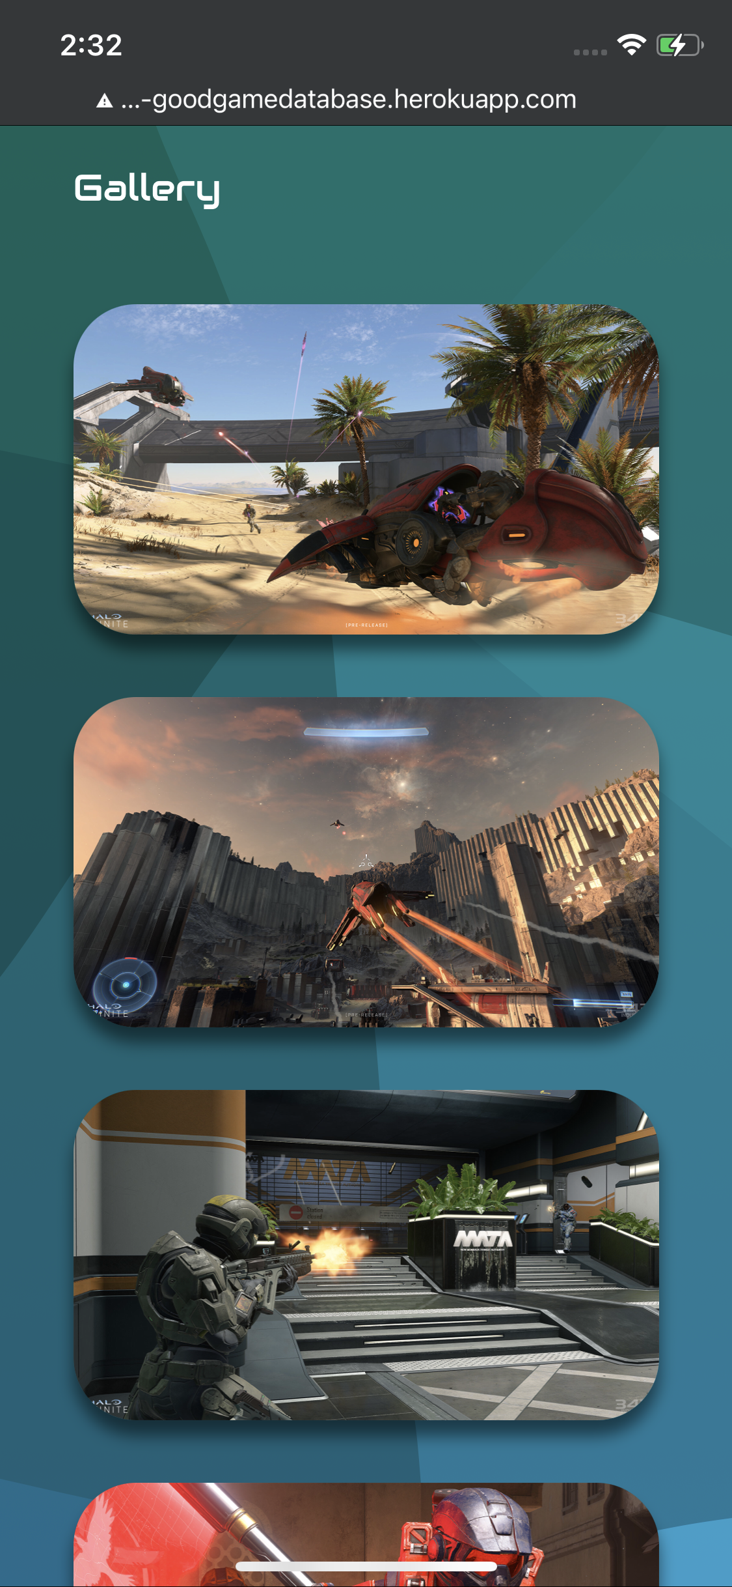
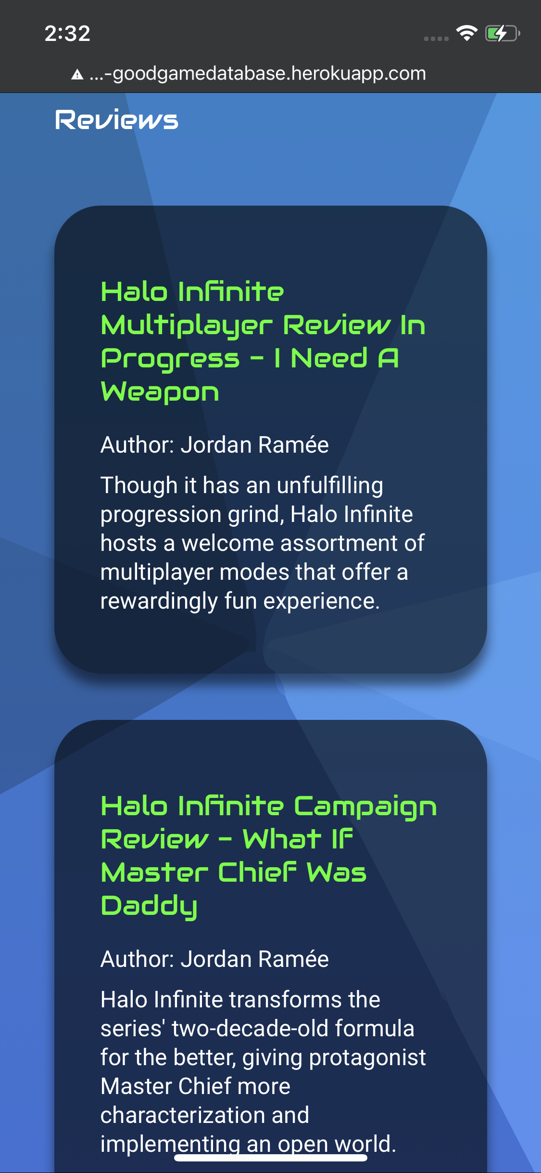
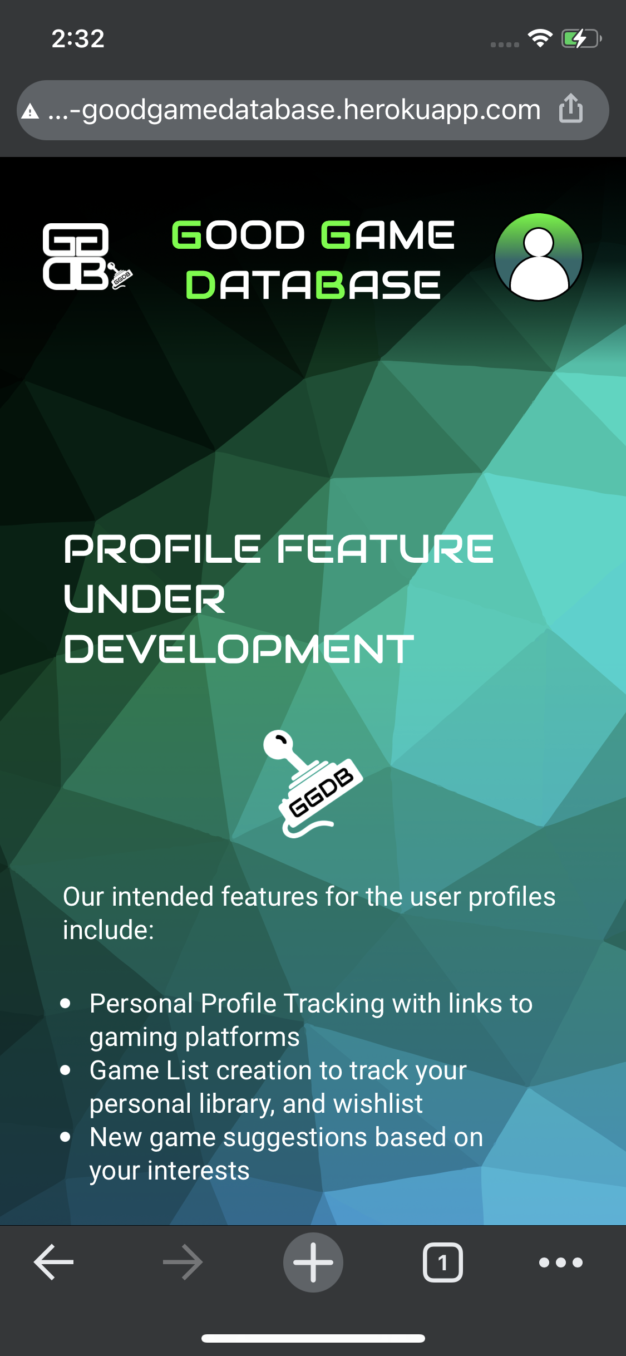
Progress - Benchmark 3
iPhone Screenshots - Part 2

Slide 16
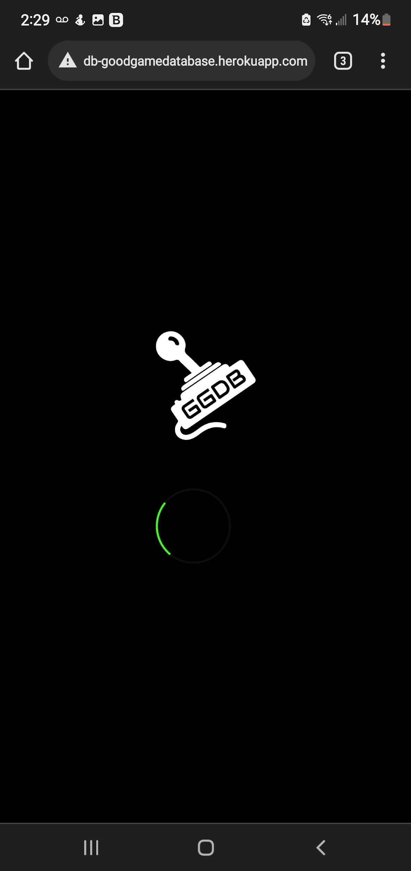
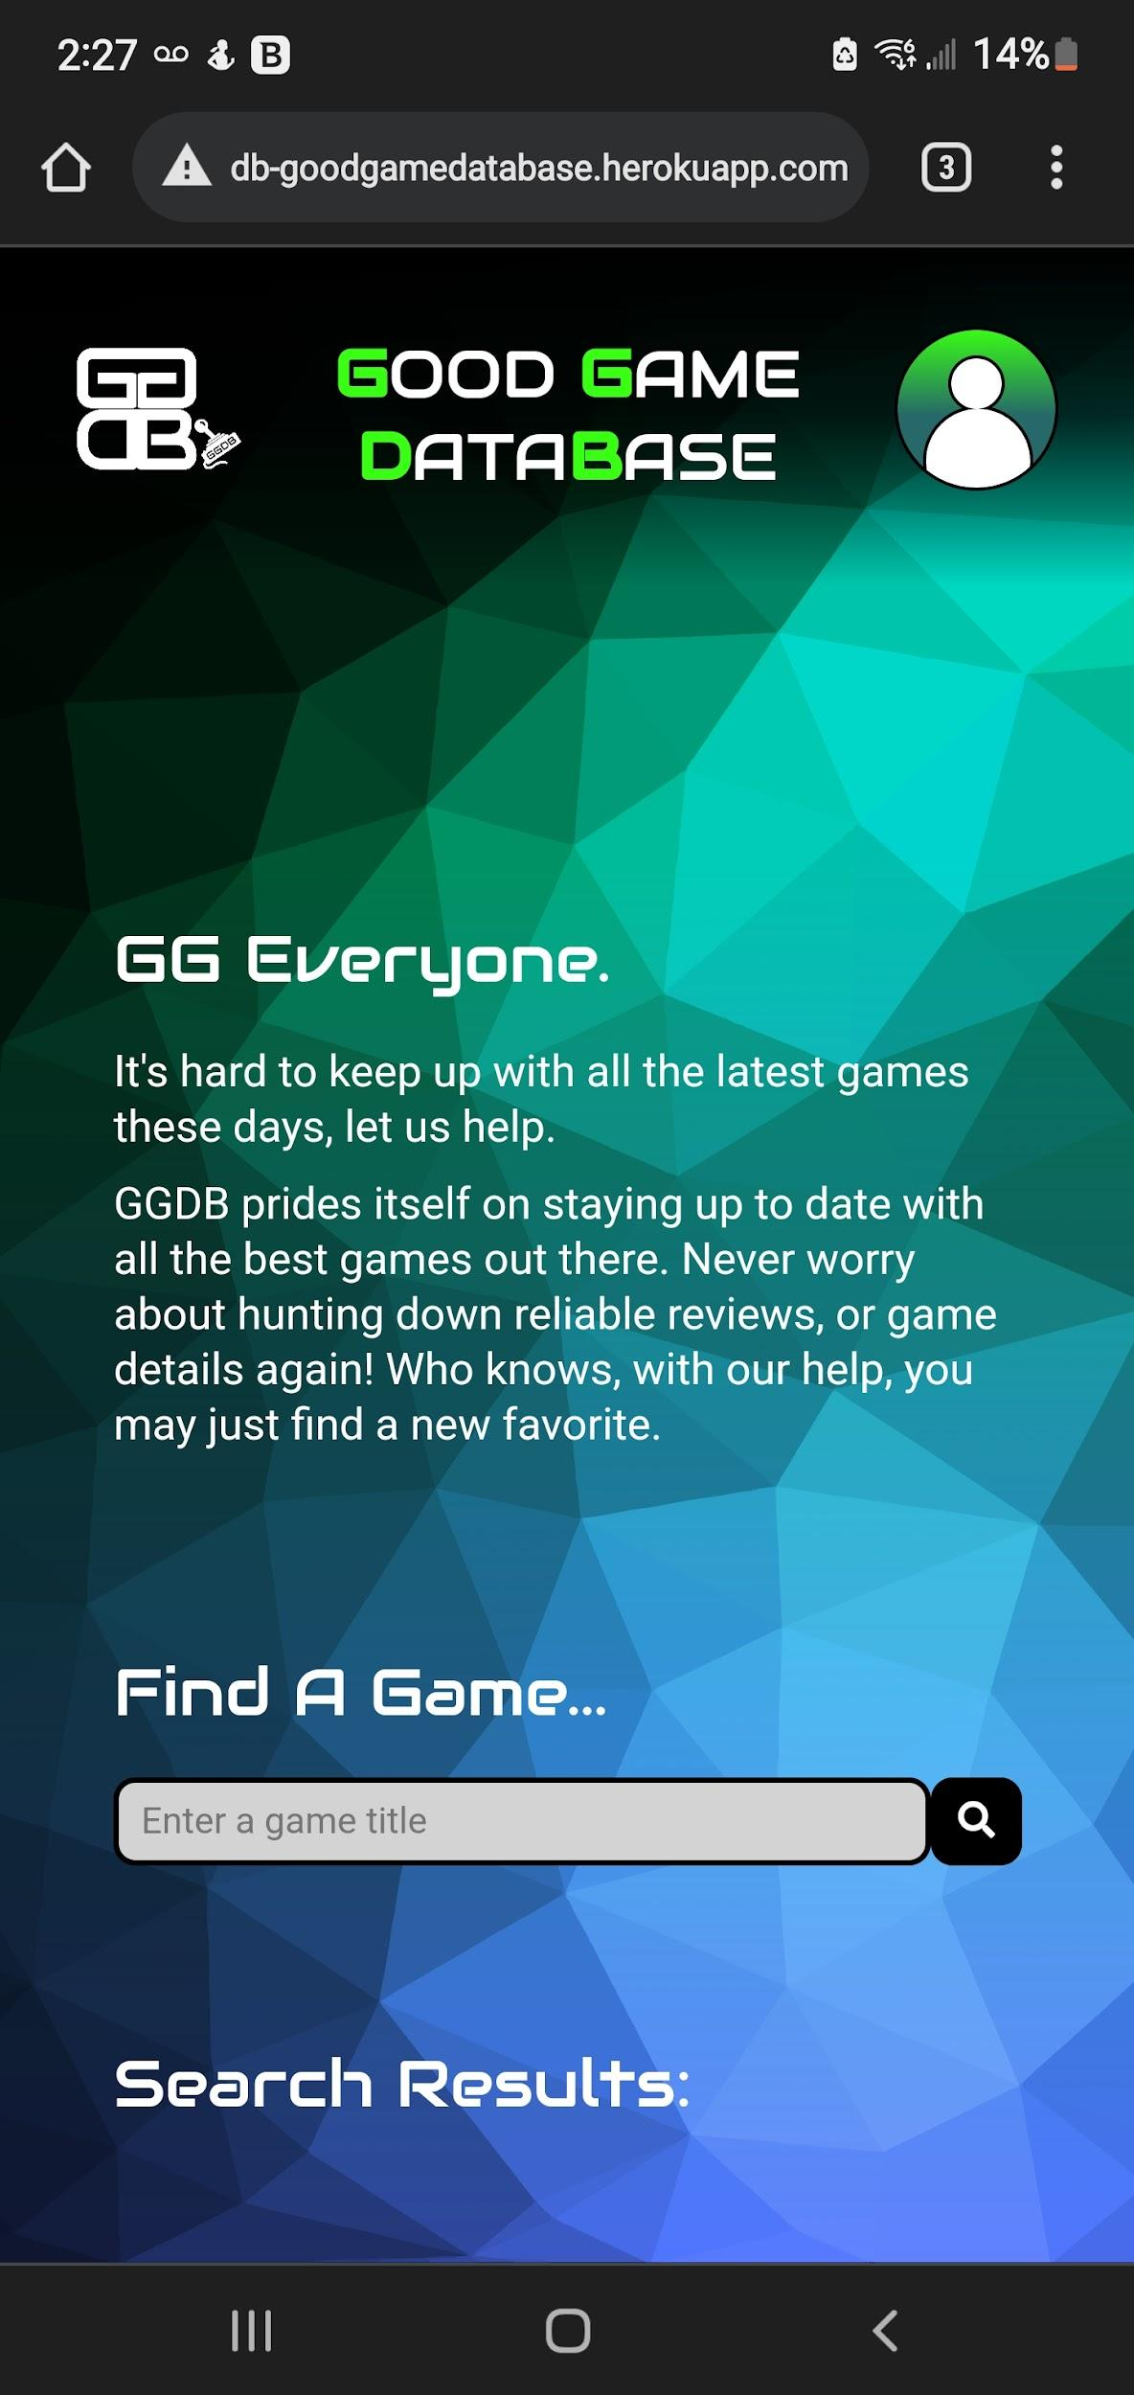
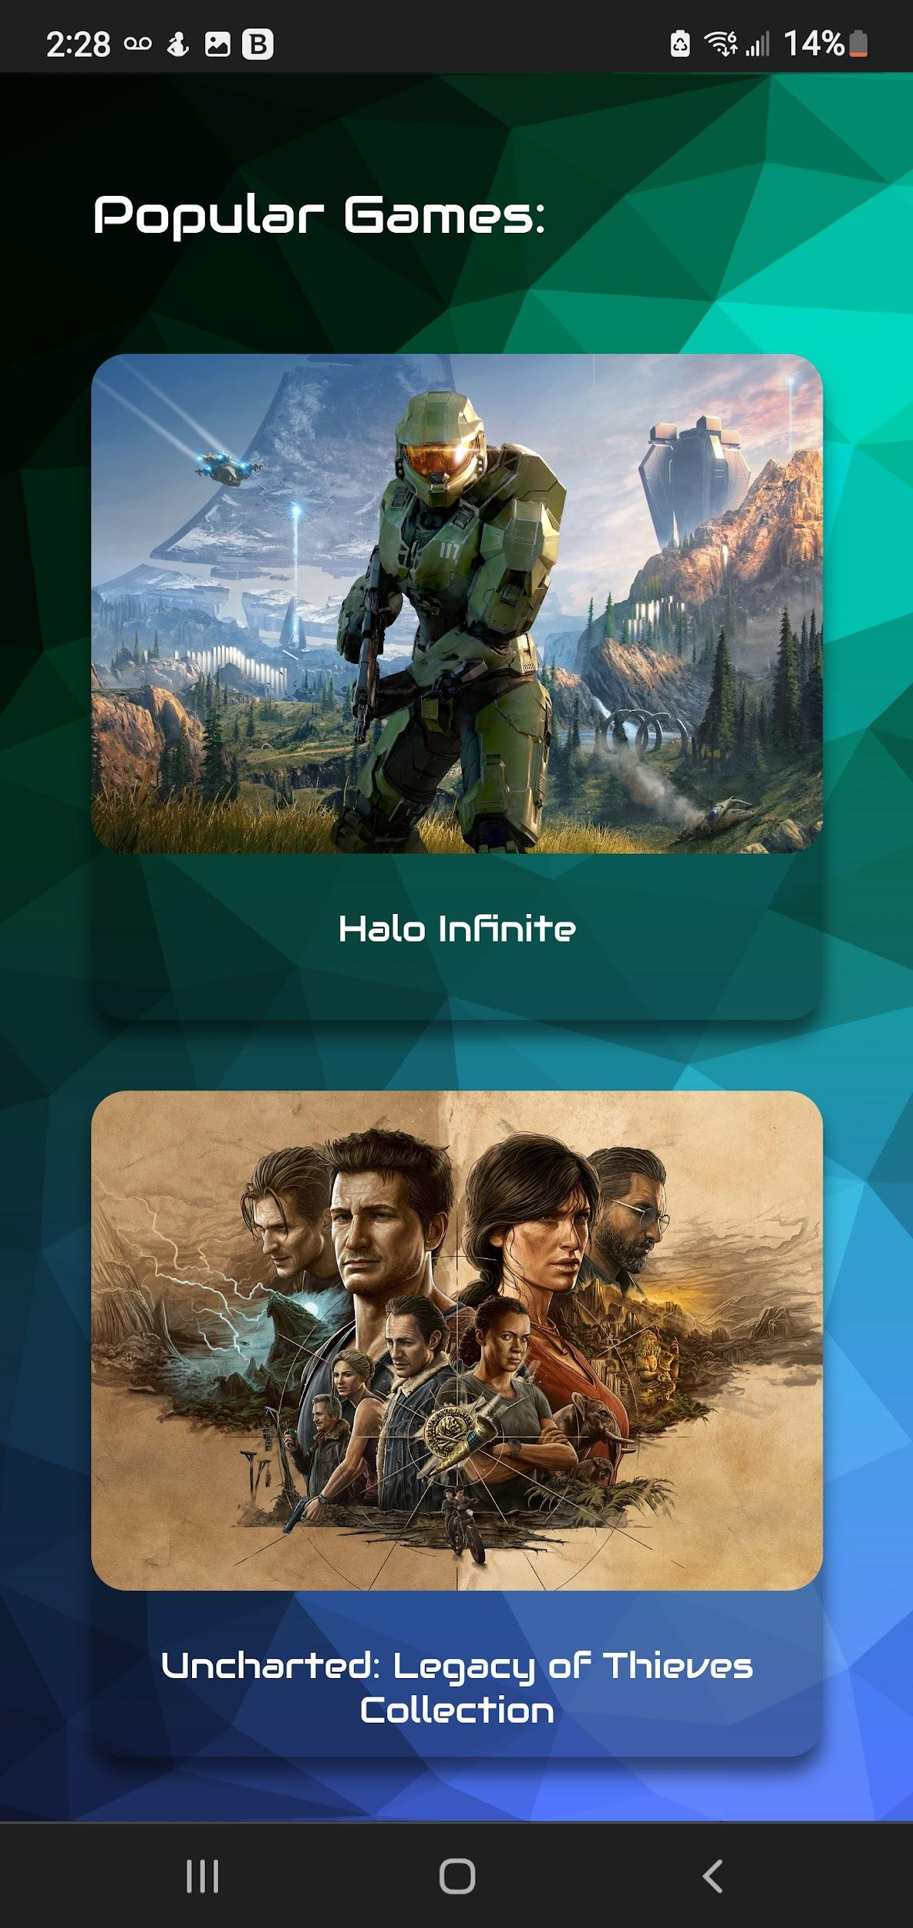
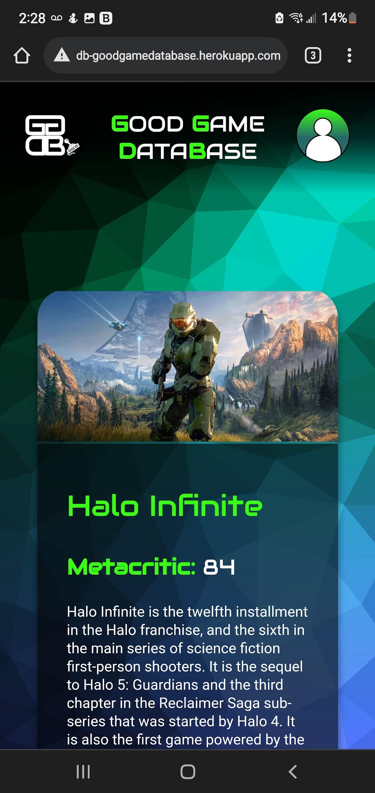
Progress - Benchmark 3
Android Screenshots - Part 1

Slide 17
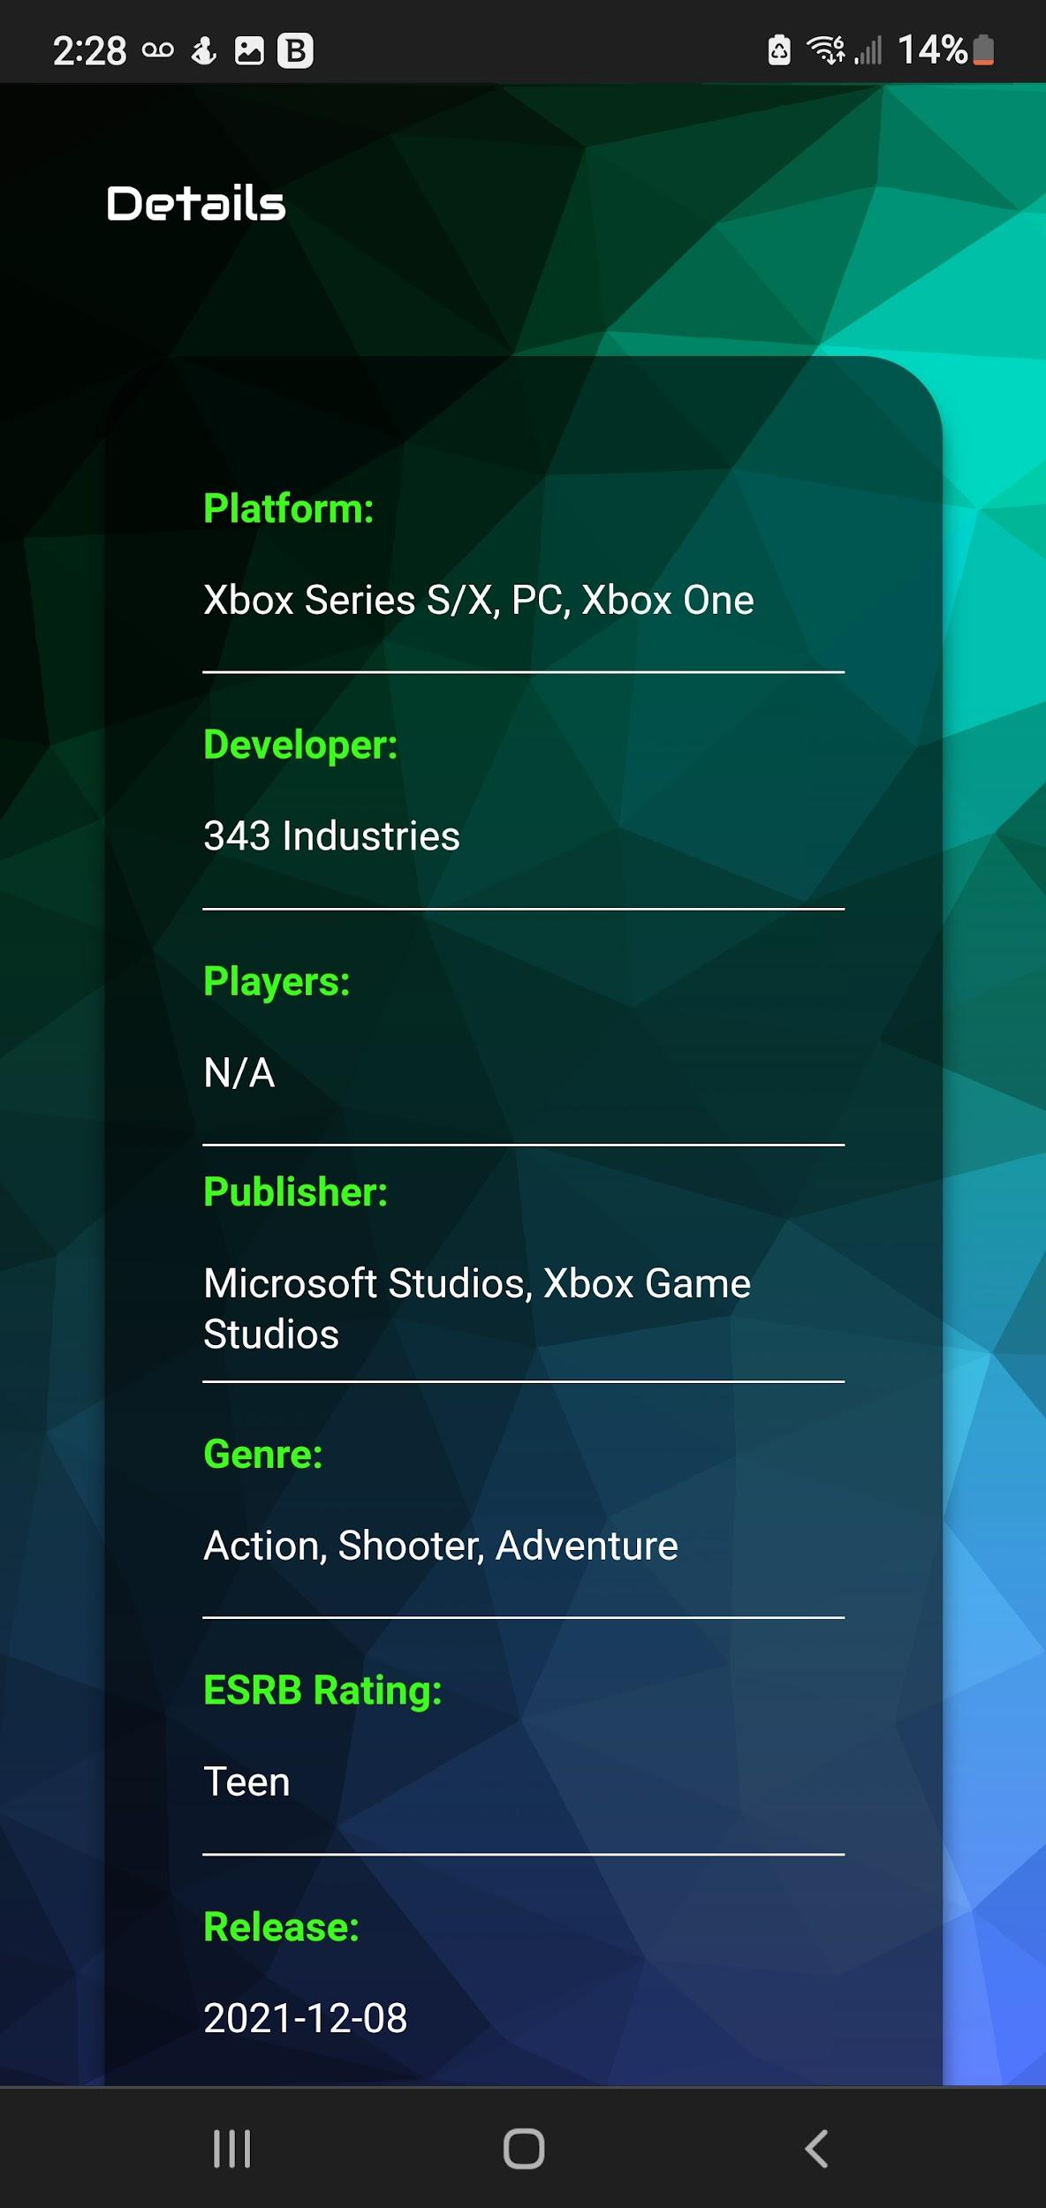
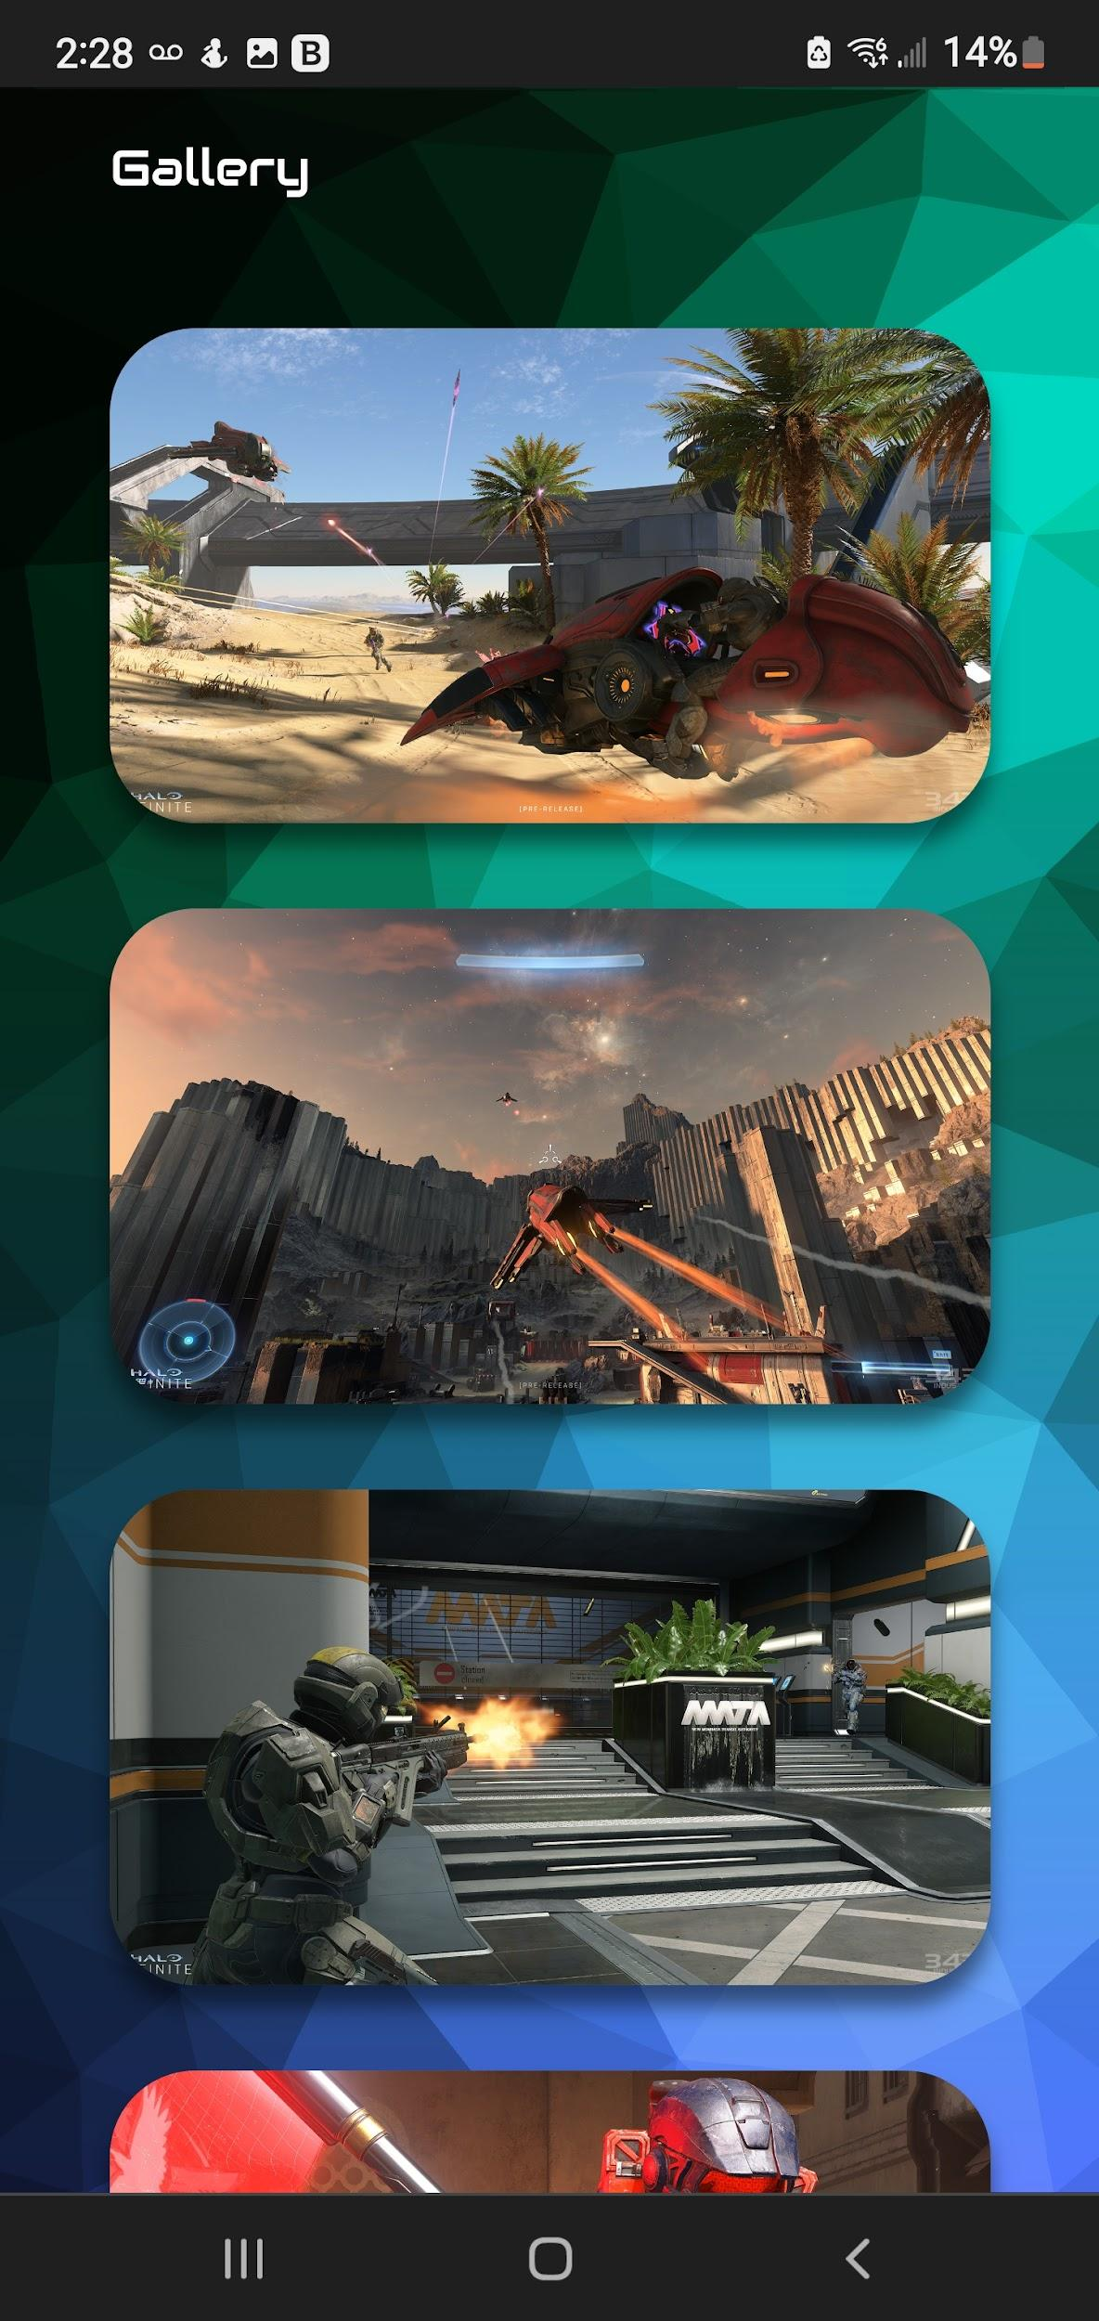
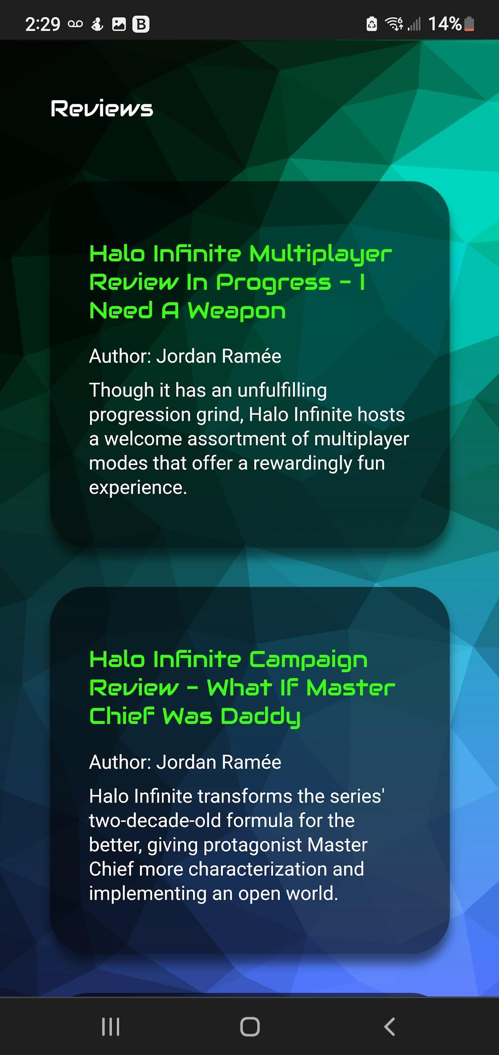
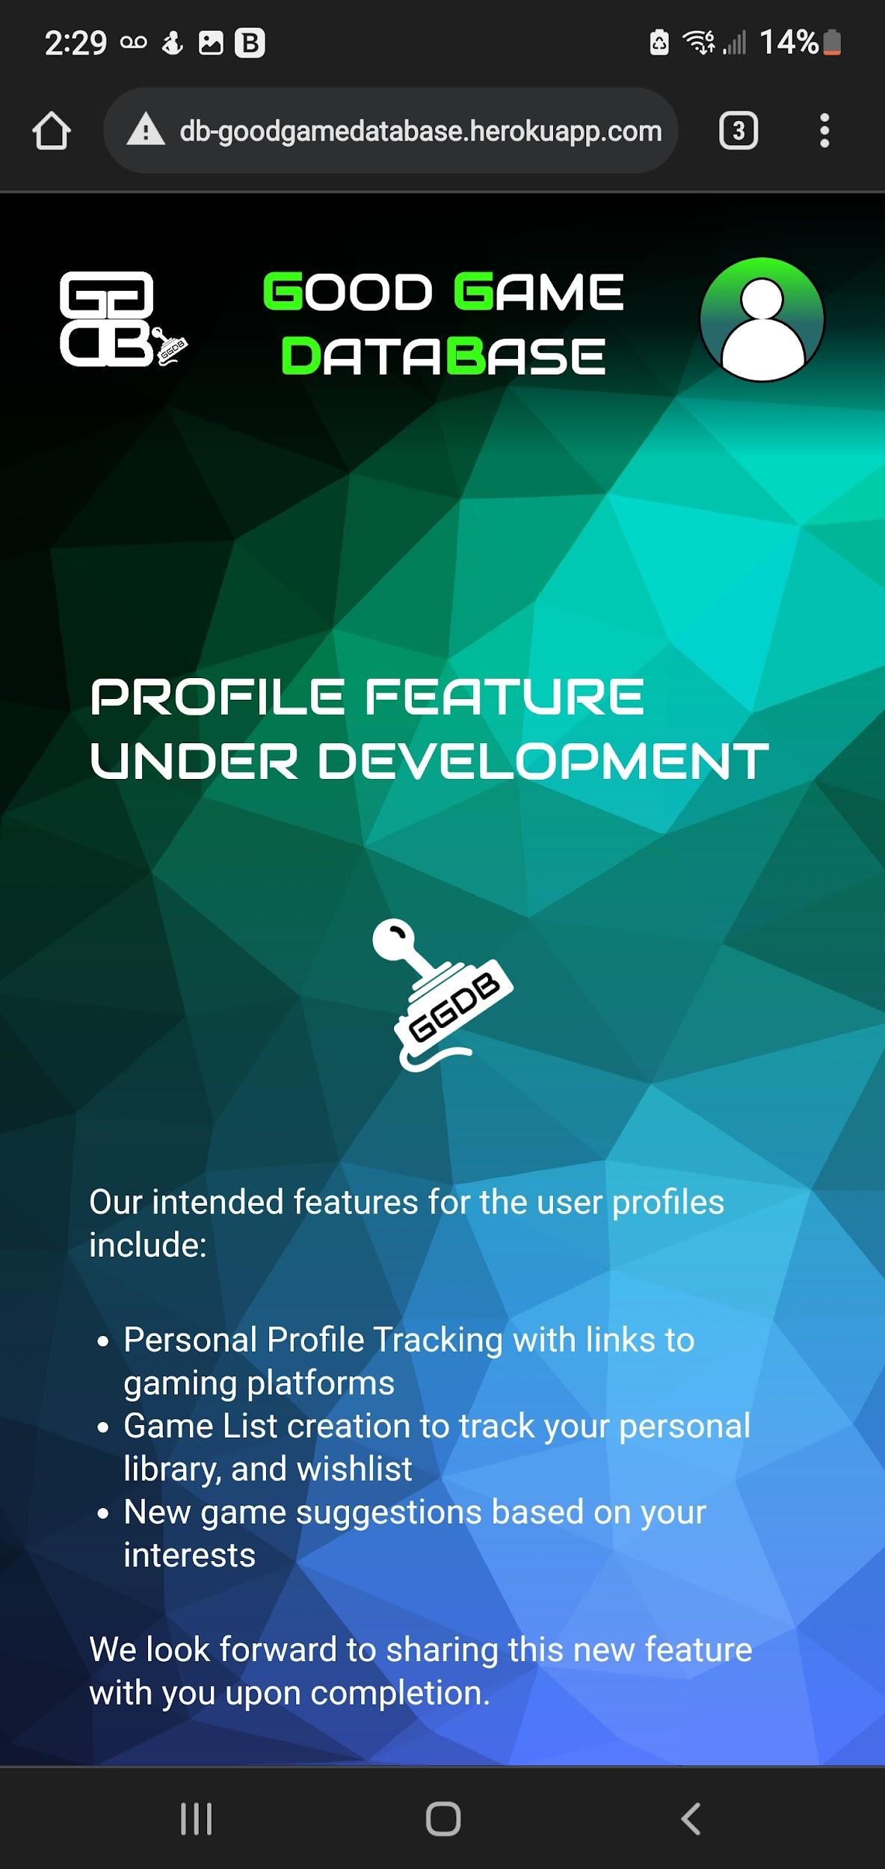
Progress - Benchmark 3
Android Screenshots - Part 2

Slide 18
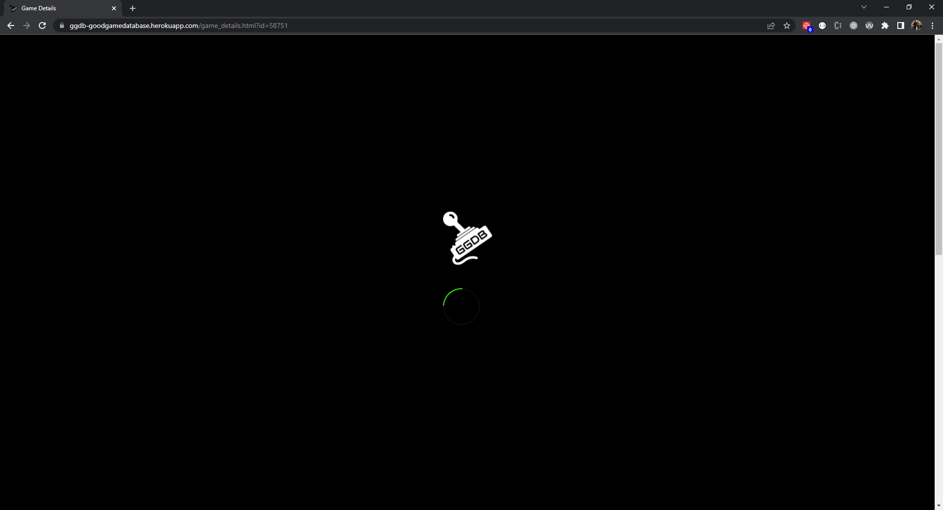
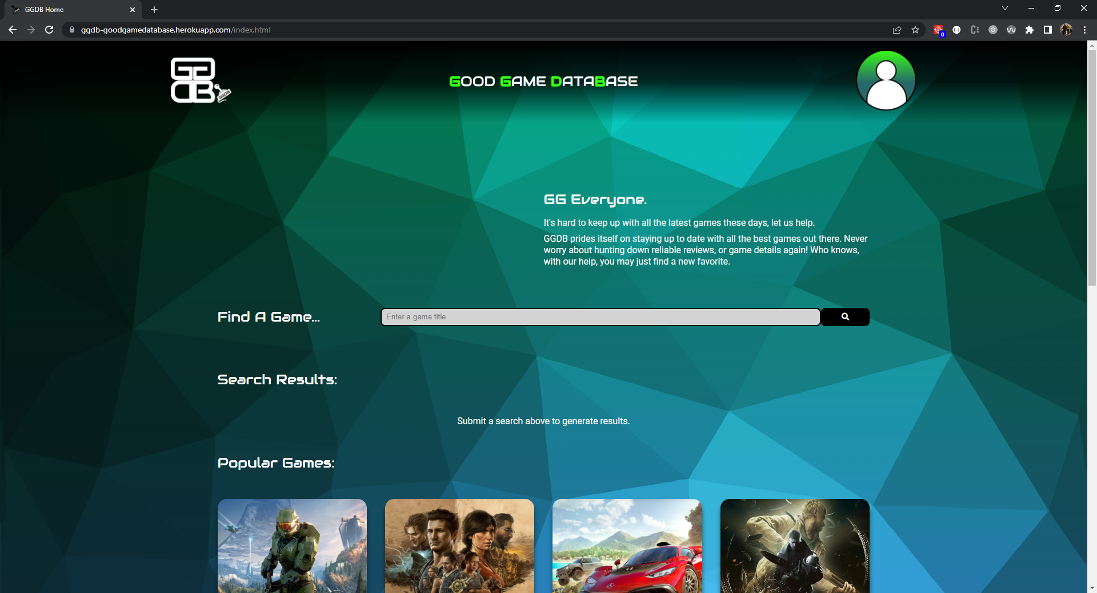
Progress - Benchmark 3
Desktop Screenshots (Chrome) - Part 1

Slide 19
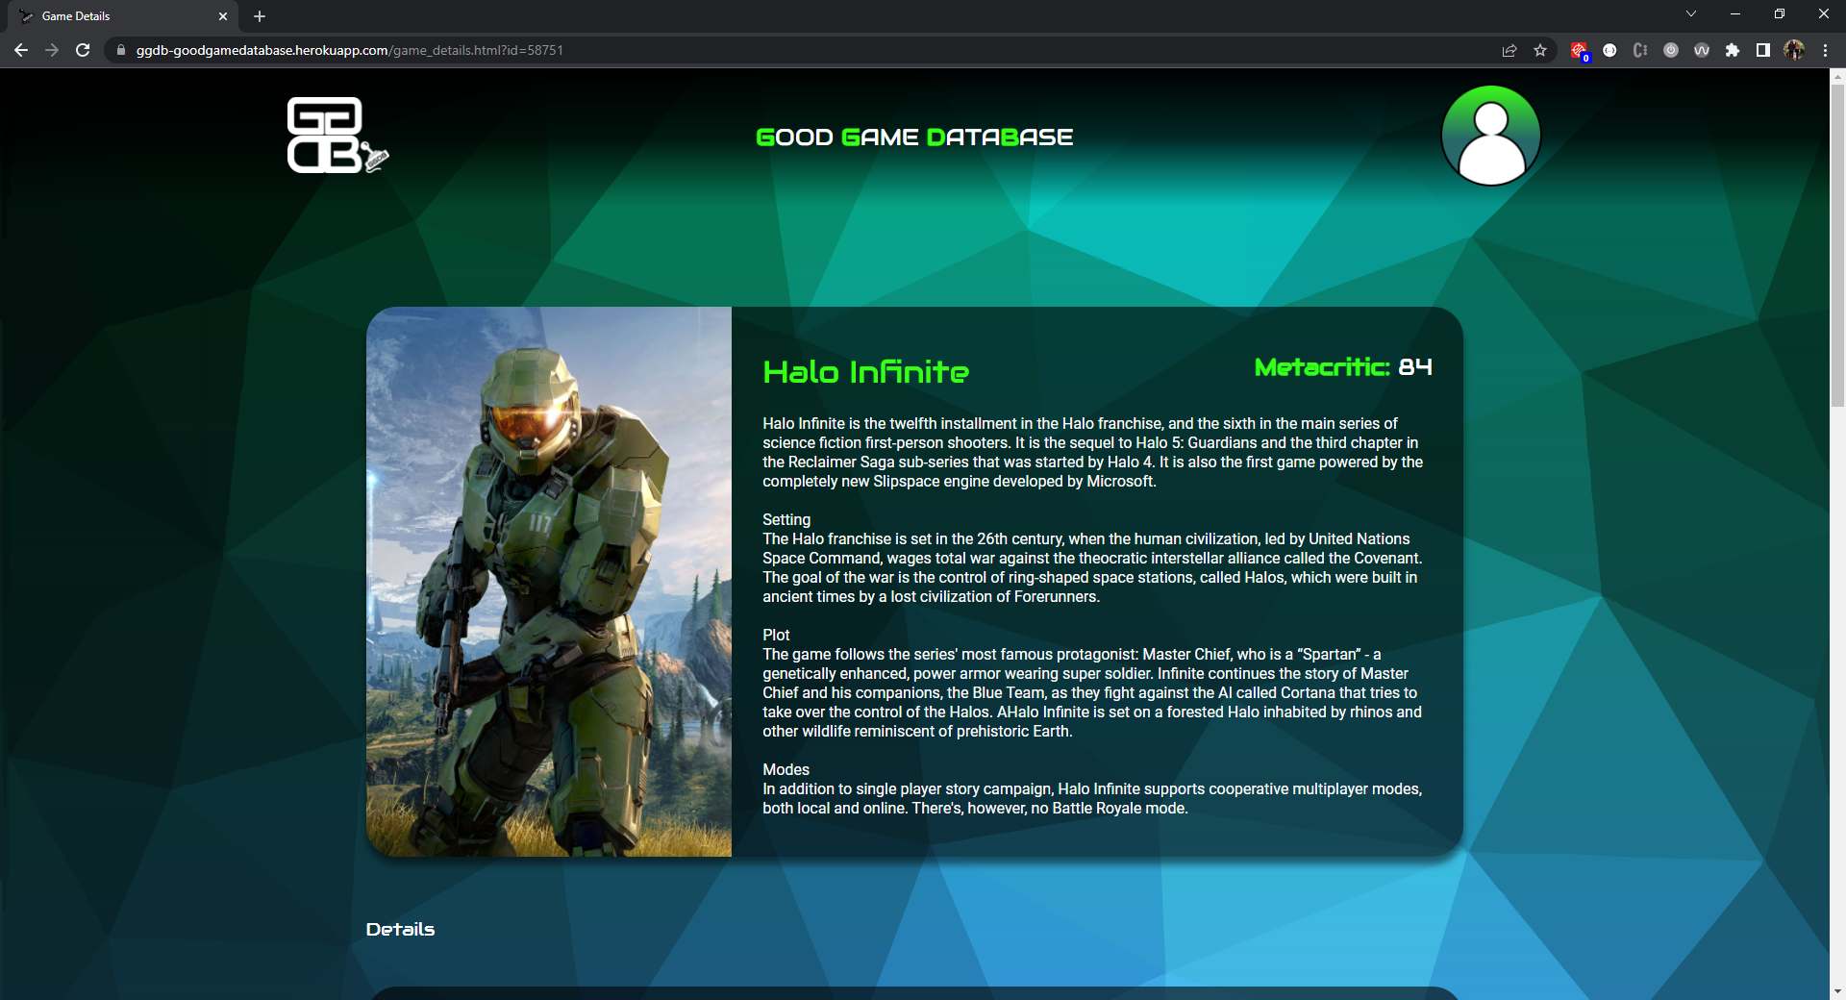
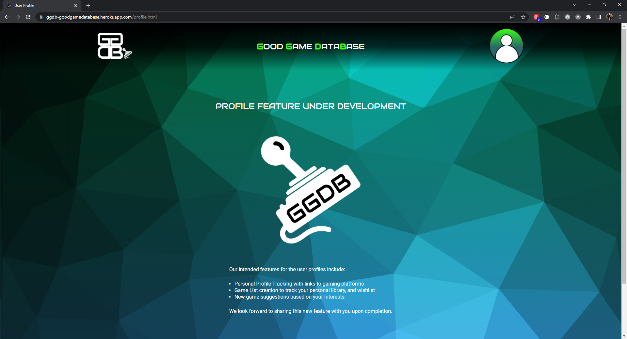
Progress - Benchmark 3
Desktop Screenshots (Chrome) - Part 2

Slide 20
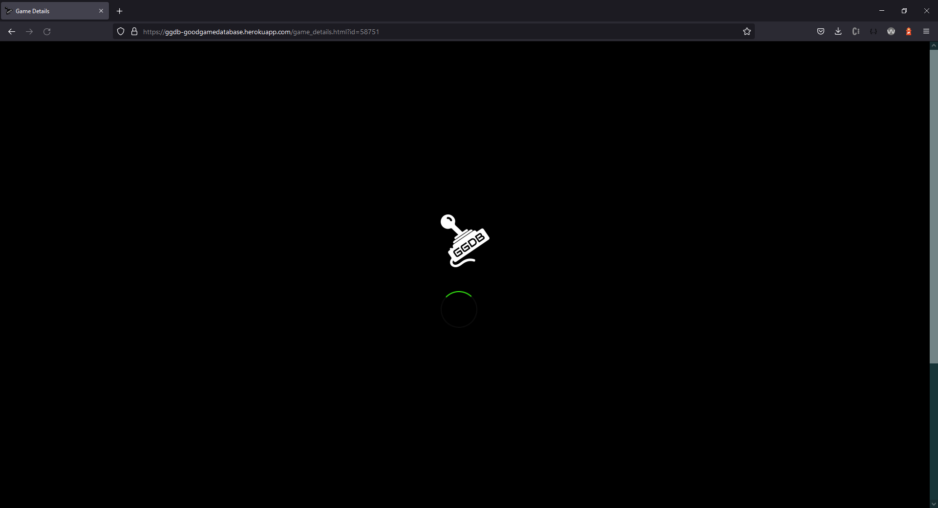
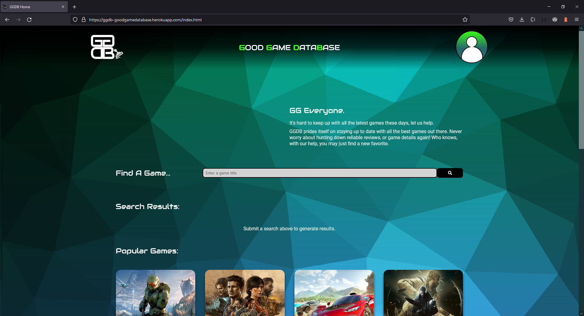
Progress - Benchmark 3
Desktop Screenshots (FireFox) - Part 1

Slide 21
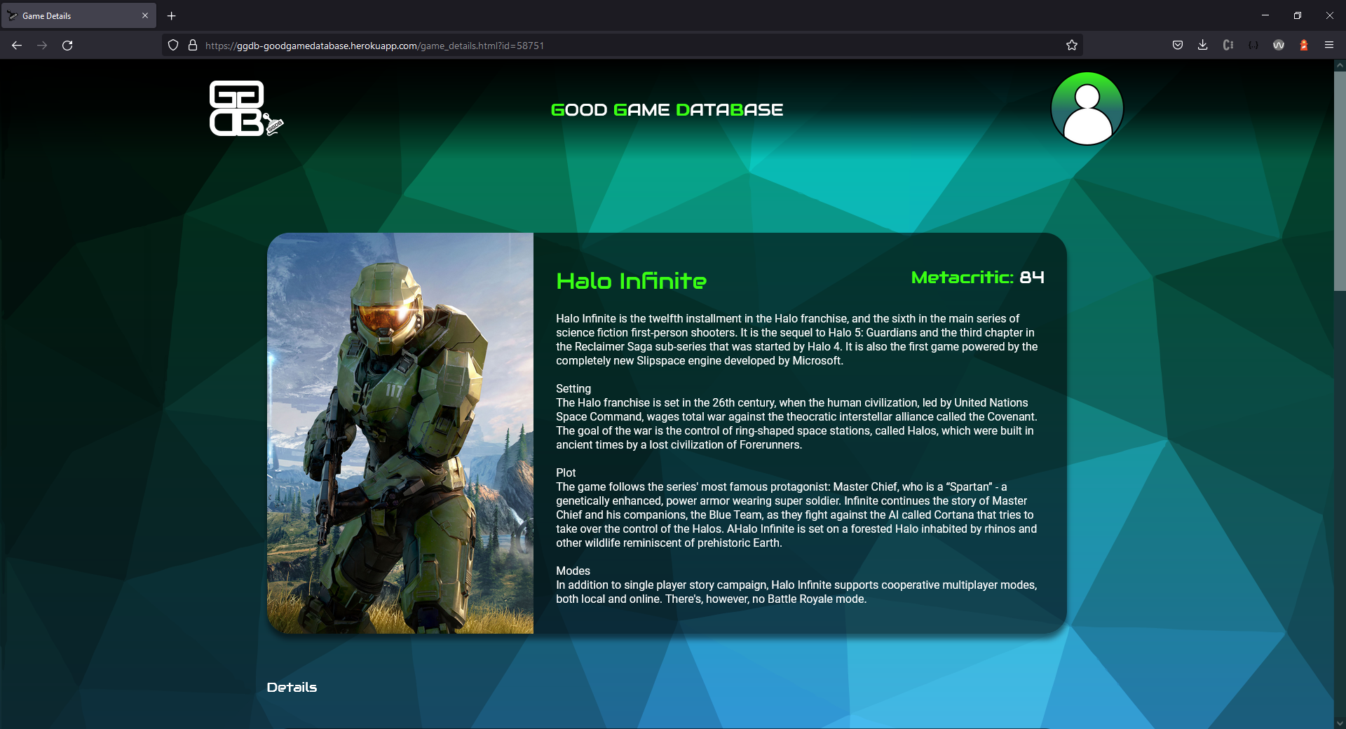
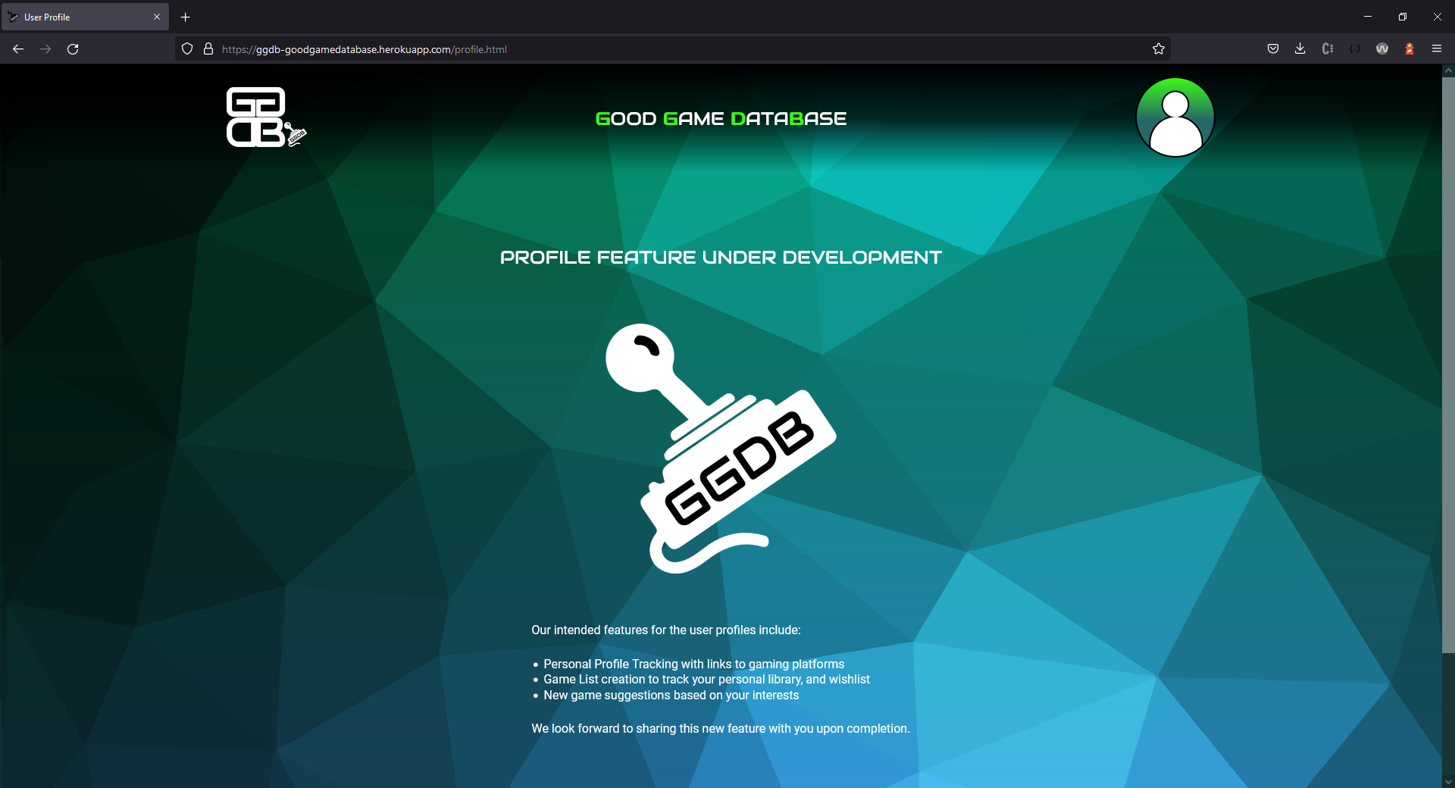
Progress - Benchmark 3
Desktop Screenshots (FireFox) - Part 2

Slide 22
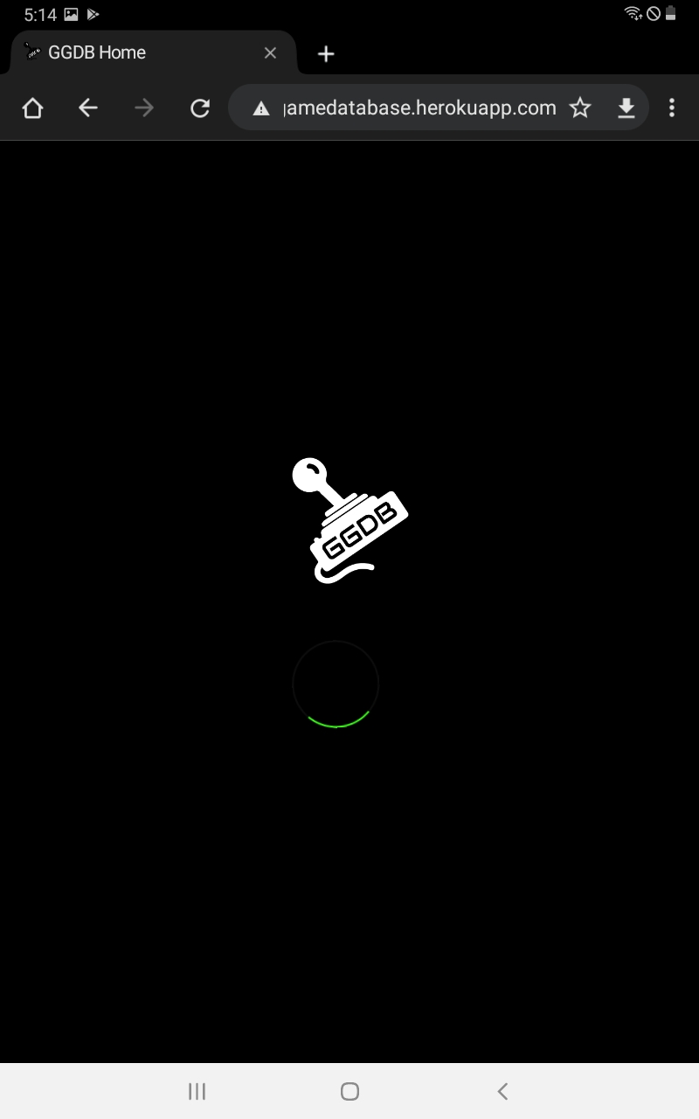
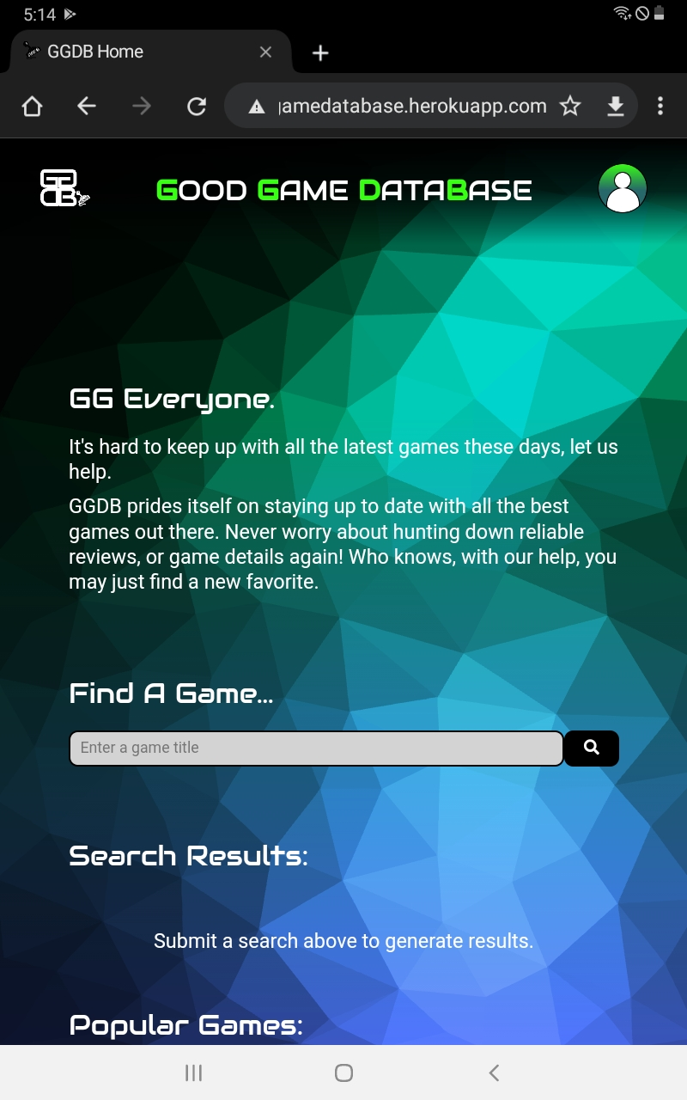
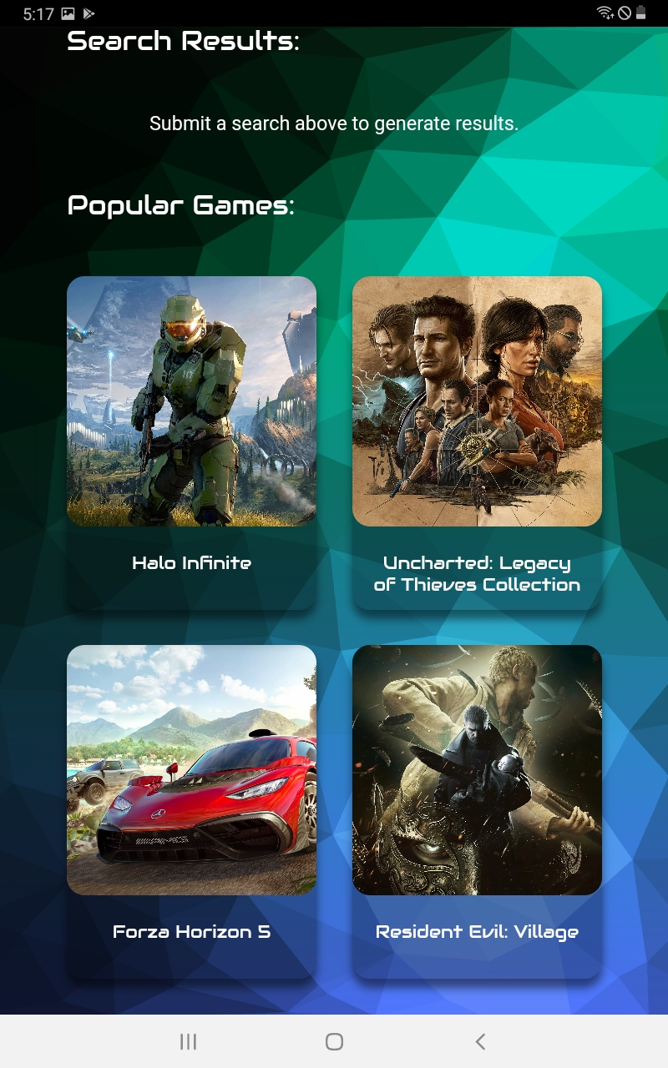
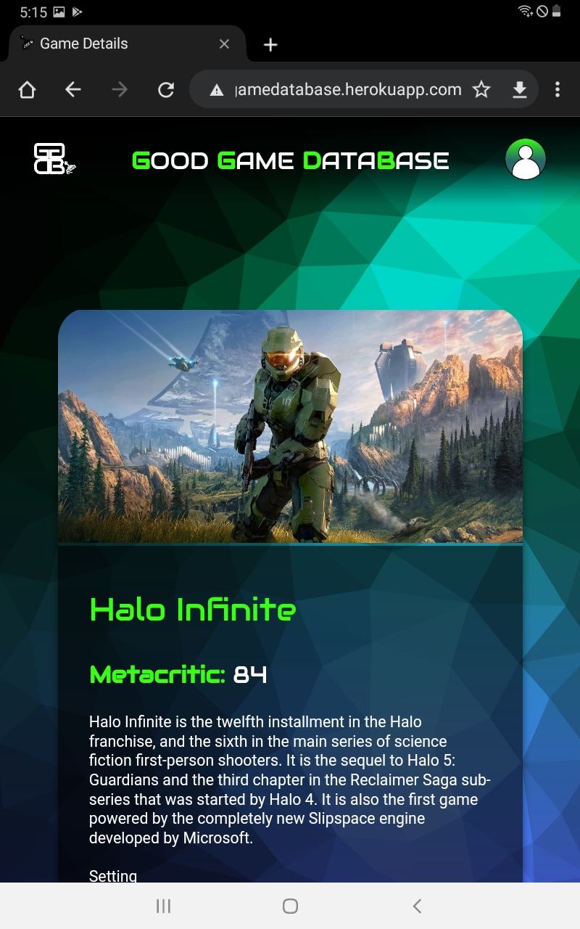
Progress - Benchmark 3
Tablet Screenshots - Part 1

Slide 23
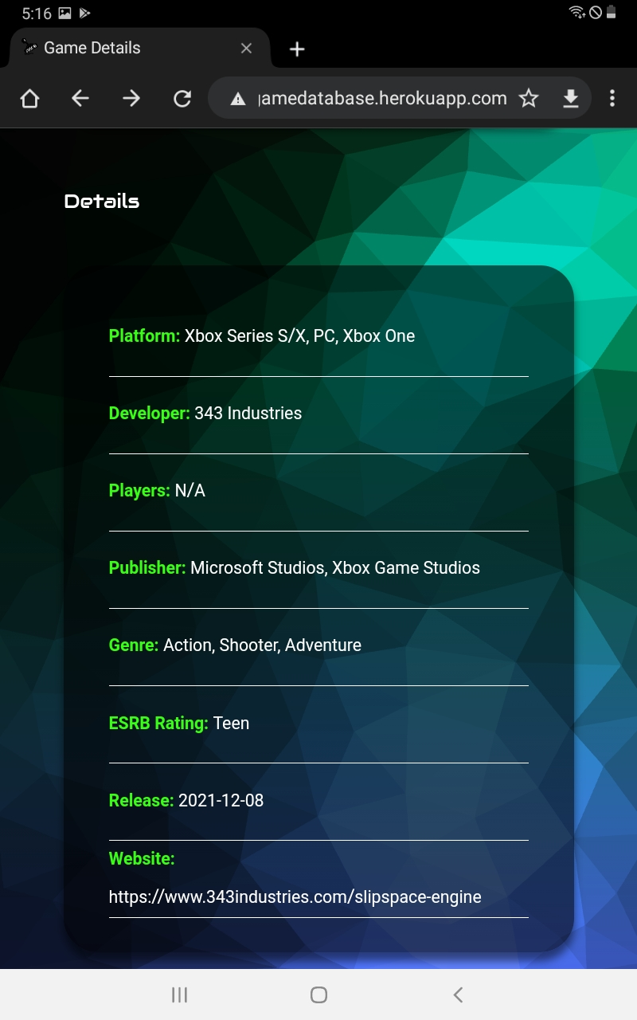
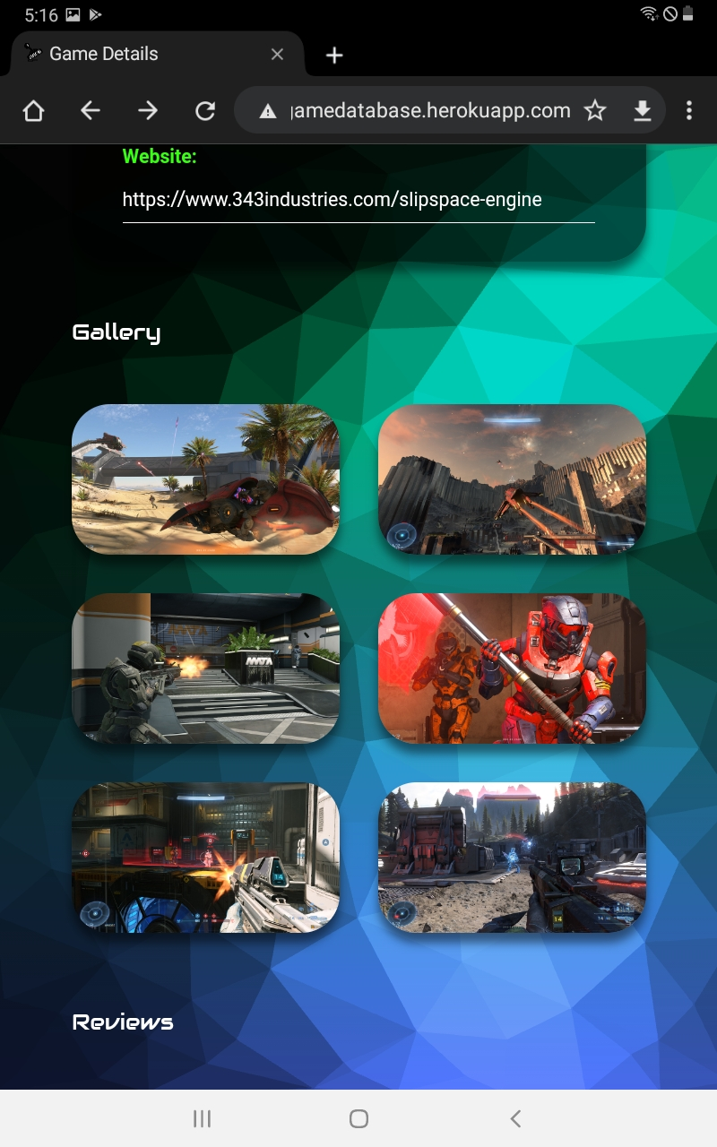
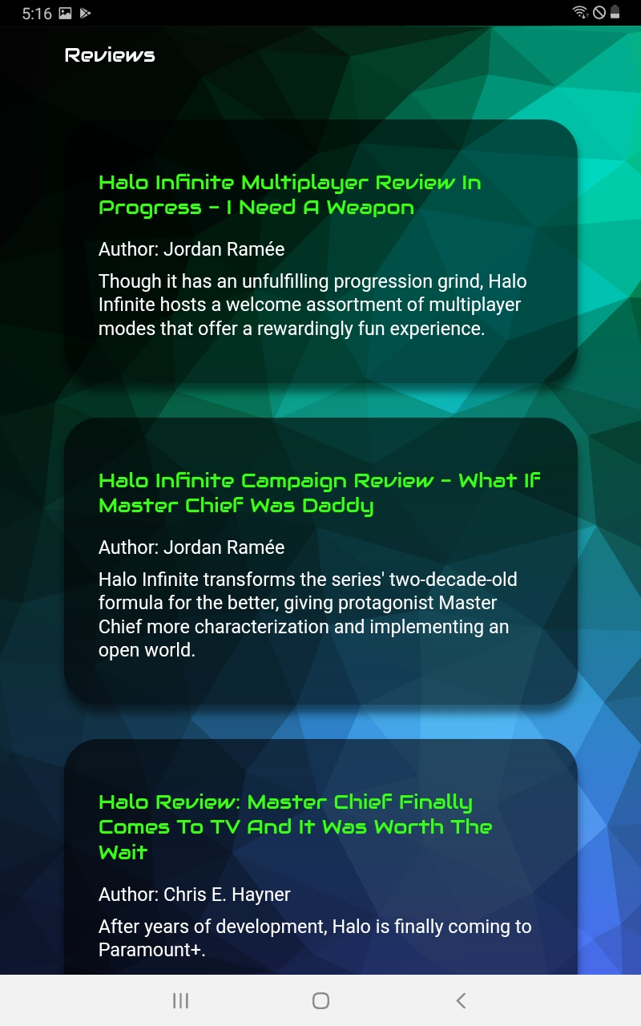
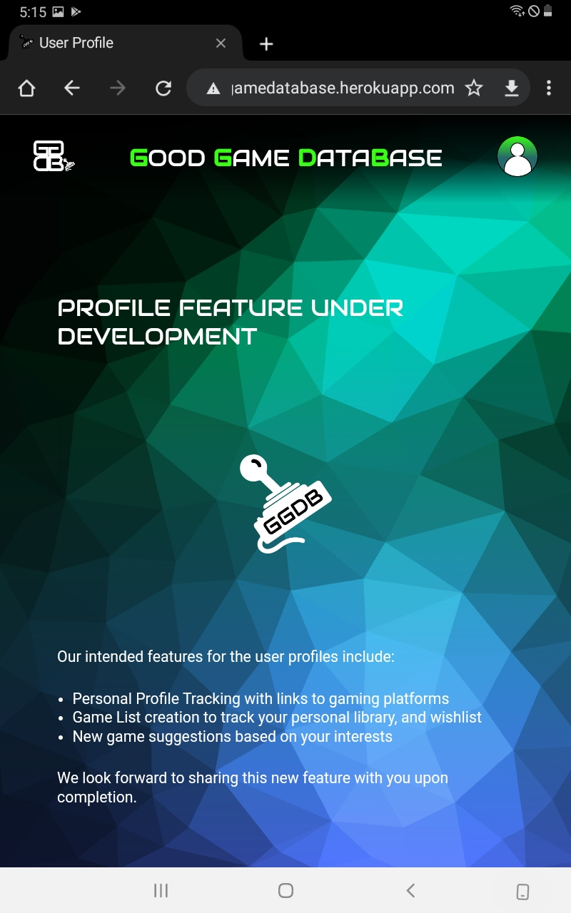
Progress - Benchmark 3
Tablet Screenshots - Part 1

Slide 24
Conclusion
Project Challenges
As with any project, I faced my fair share of challenges along the way. These included:
Building an app at this scale
Passing/accessing data across application pages
Leveraging multiple API sources
Project organization and structure
Personal constraints including time restrictions, illness, life-interruptions
I have pushed past these challenges to the best of my ability and I am quite happy with how my project turned out.

Slide 25
GAME OVER

